Slide 1
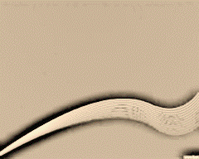
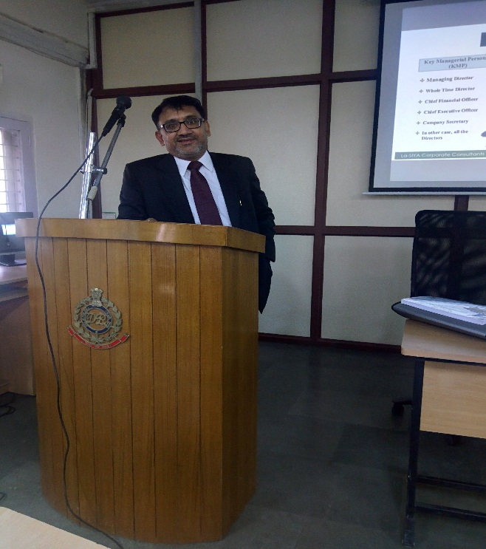

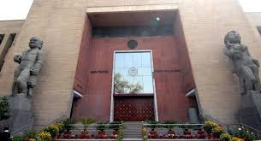

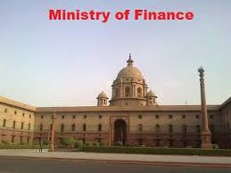


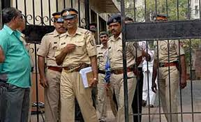


Only for Academic purposes
Cheating and its Ingredients
Criminal inquiry procedure
Dr. Sanjeev Gupta

Slide 2



Ways of doing Business
Partnership/ Limited Liability Partnership (LLP)
Proprietorship
Company

Slide 3
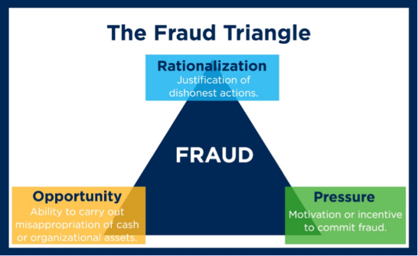
Why Do People Cheat ?
It is a shortcut to Success
Cheat Because others are doing so
People feel no one is Watching
People feel that is the best option for them

Slide 4


Who is a Typical Cheaters ?
  Age :- 35-45
  Gender- Male
  Experience-
  Highly Educated
  Continuing in service in one organization for 10 years or more

Slide 5
Are Cheating and Corruption the Same ?
“Cheating” uses to obtain an unfair advantage.
“Corruption” is the illegal use of an official position.
Can there be Red Flags?
Yes
Can You Identify Fraudster?
Yes

Slide 6

Cheating is an act of a Person and done by a Person

Slide 7
Section 415
Whoever, by deceiving any person, fraudulently or dishonestly induces the person so deceived to deliver any property, to any person, or to consent that any person shall retain any property, or intentionally induces the person so deceived to do or omit to do anything which he would not do or omit if he were not so deceived, and which act or omission causes or is likely to cause damage or harm to that person in body, mind, reputation or property, is said to “cheat”.

Slide 8
SOME ILLUSTRATIONS
TO
EXPLAIN CHEATING

Slide 9
Illustration A :
A, by falsely pretending to be in the Civil Service, intentionally deceives Z, and thus dishonestly induces Z to let him have on credit goods for which he does not mean to pay. A cheats.

Slide 10
Illustration B :
A, by putting a counterfeit mark on an article, intentionally deceives Z into a belief that this article was made by a certain celebrated manufacturer, and thus dishonestly induces Z to buy and pay for the article. A cheats.

Slide 11
Illustration C :
A, by exhibiting to Z a false sample of an article, intentionally deceives Z into believing that the article corresponds with the sample, and thereby dishonestly induces Z to buy and pay for the article. A cheats.

Slide 12
Illustration D :
A, by tendering in payment for an article a bill on a house with which A keeps no money, and by which A expects that the bill will be dishonoured, intentionally deceives Z, and thereby dishonestly induces Z to deliver the article, intending not to pay for it. A cheats.

Slide 13
Illustration E :
A, by pledging as diamonds articles which he knows are not diamonds, intentionally deceives Z, and thereby dishonestly induces Z to lend money. A cheats.

Slide 14
Illustration F:
A intentionally deceives Z into a belief that A means to repay any money that Z may lend him and thereby dishonestly induces Z to lend him money, A not intending to repay it. A cheats.

Slide 15
Illustration G :
A intentionally deceives Z into a belief that A means to deliver to Z a certain quantity of indigo plant which he does not intend to deliver, and thereby dishonestly induces Z to advance money upon the faith of such delivery. A cheats; but if A, at the time of obtaining the money, intends to deliver the indigo plant, and afterwards breaks his contract and does not deliver it, he does not cheat but is liable only to a civil action for breach of contract.

Slide 16
Illustration H :
A intentionally deceives Z into a belief that A has performed A’s part of a contract made with Z, which he has not performed and thereby dishonestly induces Z to pay money. A cheats.

Slide 17
Illustration I :
A sells and conveys an estate to B. A, knowing that in consequence of such sale he has no right to the property, sells or mortgages the same to Z, without disclosing the fact of the previous sales and conveyance to B, and receives the purchase or mortgage money from Z. A cheats.

Slide 18
Section 420 Indian Penal Code, 1860

Slide 19
Essential elements of Section 420
Cheating
Dishonest inducement to deliver property or to make, alter or destroy any valuable security or anything which is sealed or is capable of being converted into a valuable security and
Mens rea of the accused at the time of making the inducement.

Slide 20
Cognizance of an offence under Section 420
Falls under the category of Non Bailable.
It is triable by Magistrate of the First Class and
FIR or Application u/s 156(3) or Private Complaint u/s 200 may be preferred.

Slide 21
What is meant by deceiving
Deceiving means causing to believe what is false or misleading as to a matter of fact. But all deceptions does not amount to cheating.
Deceptions only with fraudulent and dishonest intentions amount to cheating.
If A sold the bat to B with the honest belief that the bat was of Sachin Tendulkar’s, that will not amount to cheating.

Slide 22
Cheating in a contract
A mere breach of contract will not be cheating. A singer promised to perform in a certain concert and asked their organizer to arrange for an orchestra. The organizer made all the required arrangement as per contract.
The singer arrived at the concert place and everything was set to go. At the meantime, singer backed out from singing owing to his personal reasons. The organiser filed a case for cheating against the singer

Slide 23
For the offence, prior dishonest intention is required
For any sort of cheating, there has to exist a deceiving content right from the beginning of the contract.
If in a contract, the party failed to pay for an EMI, this will not amount to cheating or fraud at the first instance. For this to be an offence a prior intention to deceive the seller must be present in the mind of the buyer.

Slide 24
IMPORTANT POINTS
Ingredients of Cheating
Fraudulently or Dishonestly
Injury
Property
Mens Rea
Cheating by Personation
Punishment for Cheating
Punishment for cheating by personation
Cheating and dishonestly inducing delivery of property
Section 420 is an aggravated form of cheating

Slide 25
Ingredients
of Cheating
The accused must have induced fraudulently or dishonestly a person.
The deceived should be induced to deliver any property to any person or to consent that any person shall retain any property.
If the person deceived, must be intentionally induced by the wrong-doer to do or omit to do anything which he would not do or omit if such deceived person was not so deceived.
The deceived should suffer any damage or harm in body, mind, reputation or property by the deceitful act of the wrong doer.
A dishonest concealment of facts is also treated as a cheating.

Slide 26
Fraudulently
or
Dishonestly
These words in the Section are most important. These words denote the elements of deception and dishonest intention. A willful misrepresentation of a fact with intention to defraud another person is cheating.

Slide 27
INJURY
When a person cheats another, the deceived person must have suffered or injured in body, mind, reputation or property. Where no loss or damage was caused to the person deceived, the accused cannot be punished for the offence of cheating.

Slide 28
Property
Property may be of any kind movable or immovable. The property need not necessarily belong to the person deceived. A passport, an admission card to an examination, title deeds, salary of a person, health certificate, etc., are deemed as property for the purpose of this Section and Section 420.

Slide 29
Mens Rea
Mens Rea (guilty intention) is an essential element of the offence of cheating. The very purpose and aim of the accused are to procure the property by means of deceiving the victim/ complainant. The accused induces the deceived with fraudulent and dishonest intention.

Slide 30
Depending on the nature and gravity of an offence’s if they can be classified under any of the following heads:
Classification of Offences
Bailable and non-bailable offence
Cognizable and non-cognizable offence.
Compoundable and non compoundable offence

Slide 31
Cognizable & Non-Cognizable offence
Cognizable offences:
An offence, where a police offer can arrest without a warrant.
Non-cognizable offences:
An offence, where a police officer can arrest only with a warrant

Slide 32
Cognizable Offence
Cognizable offences are those where a police officer can arrest without warrant
And such cases, after arrest has been made, the accused will be produced before a magistrate, and he may require the police officer to investigate the matter
After investigation, if the case is made out, i.e. charge sheet filed goes against accused, the magistrate can order for arrest.
During the pendency of trial, bail application can be moved before the concerned magistrate
Cognizable offences are both bailable, and non-bailable

Slide 33
Chapter 37
Deals with before crime(Ch. 8-11)
Deals with after crime( Ch. 12-32)
Preventive
Punative
Procedure to stop any criminal activity
Punishing to co- offenders
Eg:- Arrest of Anna Hazare

Slide 34
Procedure having four stages
Investigation
Inquiry
Trial
Judgement
Before Trial
Trial and later on

Slide 35
Investigation by Police
Cognizable offence / Non-Cognizable Offence
Bailable / Non-Bailable
Compoundable / Non-Compoundable

Slide 36
Cognizable/Non-Cognizable- Define in
Sec 2(c)
Sec 2(l)
Schedule I
Which is non-cognizable
Punishment more than 3 years
Punishment less than 3 years
But it is myth

Slide 37
Inquiry
154- Charge Sheet filed
155-Non-Cognizable report given
To Inquiry Evidences collected by Police
Prime facie if cases their to start trial
Further investigation to be ordered

Slide 38
Only for Academic purposes
How cognizance is taken
Sect 154- Charge Sheet
Sec 200-Complaint(Listen)
Sec 156(3) order to police to investigate & register FIR
Sec 202-Evidence by complaint
FIR
Dismiss
Issuance of Process
Sec 154
Summon Warrant
Summon
Warrant
Report u/s 173
No FIR
Only investigation,
No arrest
Police to assist
Sec 190 Cognizance
Police Report
Complaint
Sue-Moto

Slide 39
How is Criminal Proceeding initiated
For every different type of Criminal proceeding a separate procedure is involved. However in general, a brief procedure, as to how a criminal case commences, is as follows:
The fist step for initiation of any Criminal case is the complaint
The victim is called a complainant, and complainant should lodge his complaint to the police station of that area, where the offence has been committed, or where he resides. A complaint can be on behalf of the victim also
Generally, the complaint should be lodged within 24 hour of the commission of offence. However, the limitation time is different for some offences

Slide 40
This complaint can be treated as FIR by the police officer i.e. First information report on receipt of information
On receipt of such information, the concerned police officer shall record the information in writing and the person giving information shall sign it.
In case of information received, in any cognizable offence, the Police officer shall/can start the investigation without any permission/order from the Magistrate

Slide 41
Arrest during investigation
Where, the Accused is arrested by the police officer, during investigation; he shall have to be produced before a Magistrate within 24 hours.
Where, the period of investigation extends beyond, 24 hours, and the investigation has revealed sufficient grounds against the accused, then if he is still in the custody, the concerned police officer shall produce the accused before the Magistrate along with copy of the entries made in diary during investigation.
The Magistrate may either order for release of the Accused till investigation or order for further detention.
In case of further detention, the Accused shall have to be brought before the Magistrate every fifteen days.

Slide 42
During such detention , the accused can apply for bail
If during or after investigation, the police officer comes to a finding, that there is not sufficient evidence to produce the accused before Magistrate, then such accused shall be released on executing a bond.
However, if required by Magistrate he will have to appear on such date and time as directed.
On the other hand, if police officer comes to a finding that the case is fit for trial, he shall forward the accused under custody to the Magistrate, to take cognizance

Slide 43
Objects of Criminal Investigation
To establish that the crime reported has in fact been committed or to disprove it.
To fix up the identities of the accused persons if unknown.
To trace out and apprehend the accused or suspected person if a prima facie case is made out against him.
To gather and collate statements of facts and circumstances and other physical evidence in order to prove or disprove the guilt of the accused or the suspected persons.

Slide 44

Steps in conducting Investigation
Develop the theory of the case
Identify sources of information
Procure documents and data
Interrogate key persons
Assess the evidence
Determine violation of law

Slide 45

Cases involving documents
DON’TS
Documents should not be subjected to frequent and careless handling.
All parts of the documents are of potential importance. Therefore, it should not be cut, torn or trimmed.
Documents should not exposed to moisture of any kind or to strong sunlight and should never be carried in the pocket.
Documents should not be folded or unfolded unnecessarily.
Documents should not be touched with an eraser of any kind
No additions, such as underling of features thought to be significant should ever be made in the document.

Slide 46


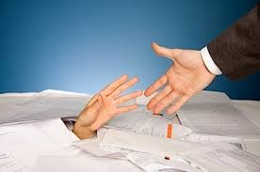
Tools of Investigation
Knowledge of Law
Sources of Information
Physical Assistance

Slide 47
Fraud under the Companies Act, 2013

Slide 48

Officers - In default
Key Managerial Personnel (KMP)
Others
Managing Director
Whole Time Director
Chief Financial Officer
Chief Executive Officer
Company Secretary
In other case, all the Directors
Share Transfer Agents
Registrars to the issue
Bankers to the issue or transfer
Person giving advice and directions to board
  other than professionals
Every director who is aware of the contravention

Slide 49
Inquiry and Investigation
Inquiry is defined as “the systematic search for information, knowledge and truth about certain things and matters of public interest.” it is a process of solving a problem through researching and probing. It involves questioning and interrogation.
“Investigation,” on the other hand, is defined as the process of inquiring into something thoroughly. It is the systematic examination and scrutiny of the factors that have affected the subject of the investigation in order to uncover facts regarding the matter.
While an inquiry is usually done through questioning and probing into the circumstances relating to the matter at hand, an investigation is done more carefully and by thoroughly inspecting details in an organized manner and assessing facts which are uncovered in the process.

Slide 50
INQUIRY | INVESTIGATION
1. According to Section 2(g) of CrPC, it means every inquiry other than trial conducted under the CrPC by a Magistrate or Court. | 1. According to Section 2(h) of the CrPC investigation includes all proceedings under the CrPC for collection of evidence conducted by a Police Officer or any person (other than a Magistrate) authorized by a Magistrate in this behalf.
2. An Inquiry primarily aims at determining the truth of reported crime or falsity of facts if any. | 2. Investigation mainly comprises the process of collection of evidence.
 | Investigation involved the following process: – Reporting at the incident of crime – Certaining facts and circumstances of the case – Discovery and arrest of suspected persons – Collection of evidence – Determining whether on the basis of facts and evidence collected there is a case to put the accused on trial or file a chargesheet.

Slide 51


Dr. Sanjeev Gupta
M.Com., FCS, LL.B, Ph.D
Director
709 A Tower B, Pearls-Omaxe, Netaji Subhash Place
Pitampura, New Delhi 110034
9810079134- 35
lasiya.inc@gmail.com
www.lasiyaconsulting.com

