Slide 1


Only for Academic purposes
Corporate Frauds and
their Regulation in India
Dr. Sanjeev Gupta

Slide 2
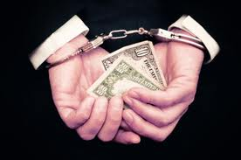

Fraud has been rampant in Corporate Sector .First time, the concept of fraud is included in the Act .
It Includes:
Any act;
Omission;
Concealment of any fact or abuse of position.
By any person or any other person with the connivance in any manner, with intent to deceive, to gain undue advantage from, or to injure the interests of, the company or its shareholders or its creditors or any person, whether or not there is any wrongful gain or wrongful loss.
SECTION 447

Slide 4
Fraud as a Civil or Criminal Wrong
Committed by Employees
Committed by Corporate

Slide 5


Frauds for and against the company
Crimes Against the Company
Crimes For the Company
Insider
Cash diversion.
Signature or endorsement forgeries.
Manipulating receivables.
Payroll manipulations.
Inventory manipulations and diversions.
Outsider
Vendor, supplier and contractor frauds.
Vendor, supplier and contractor corruption of employees.
Customer corruption of employees.
Smoothing profits.
Window dressing of Balance Sheets.
Price fixing.
Cheating Customers.
Violating governmental Regulations.

Slide 6


FRAUD TRIANGLE
Courtesy: Donalt Cressy

Slide 7




MOTIVATION
Greed
High personal debt
Poor credit rating
Addictions of money
OPPORTUNITY
Weak internal control
Excessive trust in certain employees
Unprofessional environment
Insufficient separation of duties
RATIONALISATION
View of fraud as action less crime
‘Rules do not apply to me’
Sense of entitlement

Slide 8
Types of Corporate Frauds

Slide 9

TYPES OF CORPORATE FRAUD
BRIBERY AND CORRUPTION
MISAPPROPRIATION OF ASSETS
MANIPULATION OF FINANCIAL STATEMENTS
PROCEDURE-RELATED FRAUDS
CORPORATE ESPIONAGE

Slide 10

BRIBERY
&
CORRUPTION
Cash or in Kind
Procurement Fraud
Collusion between employee and vendor
Vendor fraud
Collusion among vendors

Slide 11
MISSAPPROPRIATION OF ASSETS
Cash Frauds
Non-Cash Frauds
Receipts
Theft of Inventory
Skimming
Larceny
Falsifying receiving leads missing inventory
Disbursement
False sales Leads missing inventory
Manipulate legitimate Vendors
Pay Money Under False Premises
Theft of Fixed Assets
False wireTransaction
Fraudently write off by scrap,junk or destroyed etc.
Fraudently Credit Card Transactions
Cheque Tempering
Manipulation of Pay Rolls
Creation of shell Companies

Slide 12
FINANCIAL STATEMENT FRAUDS
Overstating Revenue
Understating Expense
Non-Disclosure/false Disclosure
False Book Enteries
Miasapplication of Funds raised through financial institutions
Mismatch of Projections and deployment of public funds raised through issues
Misclassification of heads of accounts in financial statements
Overstating Assets
Understating Assets
Investment in shares of group of companies
Transaction between sister concerns

Slide 13
PROCEDURAL FRAUDS
Carrying business ultra vires the objects
Siphoning of FDI
Refrences to BIFR
Transaction between sister concerns
Fraudently going into liquidation
Forex misuse
Merger & Amalgmations

Slide 14
Features of Corporate Fraud

Slide 15

Common types of Fraud
Features of Corporate Frauds
in India
Fraud Perpetrators
Action against Perpetrators
Accountability
SEBI’s Role in Regulating Frauds
Approach of the Adjudicating Agencies
Time Taken in Disposal of Cases

Slide 16
Who commits FRAUDS?

Slide 17

Fraud committed by…?
People who …………..
have experienced failure.
are disliked.
are impulsive and unable to postpone gratification.
are more Intelligent.
have great pressure to important objectives.
struggle to survive.

Slide 18

Victims of Fraud
Fraud by Corporate Owners, and Managers-
Customers
Shareholders
Bankers
Competitors
Insurance Companies
Government Authorities
Frauds by Corporate vendors, Suppliers, and Contractors-
Customers
Frauds by Corporate Customers-
Vendors
Frauds by Corporate Employees-
Employers

Slide 19

Regulatory Legislations for Corporate Frauds in
India

Slide 20
Major Legislations for Curbing Frauds in India
S. No. | Name of the Legislation | Enforcement Authority
1 | The Companies Act, 2013 | (i) National Company Law Tribunal (ii) Relevant department under MCA (iii) Regional Director (iv) Registrar of Companies, MCA (v) Central Government
2 | The Income Tax Act, 1961 | Income Tax Department
3 | The Money Laundering Act, 2002 | Adjudicating Authority
4 | The Benami Transaction (Prohibition) Act, 1988 | Civil Courts
5 | The Information Technology Act, 2000 | Controller of Certifying Authorities
6 | The Indian Penal Code, 1860 | District & Session Courts/ High Courts
7 | The Indian Contract Act, 1872 | Civil Courts

Slide 21
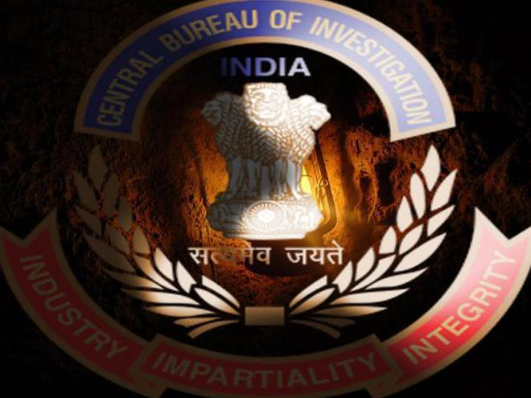
Regulatory Framework for Corporate Frauds
in India

Slide 22

-- Registrar of Companies
-- Regional Director
-- Serious Fraud Investigation Office
Ministry of Finance
-- Central Board of Direct Taxes
-- Directorate of Enforcement
-- Directorate of Revenue Intelligence
-- Pension Fund Regulation and Development Authority
Ministry of Personnel, Public Grievances and Pensions
-- Central Bureau of Investigation
-- Economic Offences Wing
Ministry of Consumer Affairs
-- Forward Markets Commission
Statutory Bodies under Parliament Enactment
-- Reserve Bank of India
-- Securities and Exchange Board of India
-- Insurance Regulatory and development authority
Ministry of Corporate Affairs
Major Regulatory Authorities
in India

Slide 23
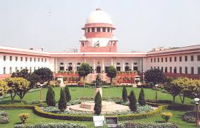

INDIAN LEGAL SYSTEM
(for fraud matters)
Supreme Court
High Court
Metropolitan City Level
Civil Side
City Civil Court
Court of small causes
Criminal Side
Session Court
Metropolitan
Magistrate Court
District Level
Civil Side
District Court
Civil Judge
- Senior Division District Judge
Junior division district Judge
Criminal Side
Session Court
Judicial Magistrate

Slide 24
Impact of Frauds on

Slide 25
Impact of Corporate Frauds
When a company suffers from fraud from any source, it must make up for it by raising costs, which ultimately means higher prices for consumers.
It can also mean less pay for employees and even cutting jobs. The effect can continue to ripple when it comes to those employees or investors who now find themselves unable to pay off loans, and credit becomes harder to obtain.
Organization tend to lose the confidence of the stockholders of the organization.
The negative publicity from the media may also have a major impact on the organization’s total reputation and stock value which could in some cases can lead to the closure of the business or an unprecedented loss of revenue.

Slide 26
Consequences of Company Fraud on Stakeholders
Loss of Confidence of Investors
Loss of Credibility of the Organisation
Loss of employees due to their switching over
Non-payment to Creditors

Slide 27
Consequences of Company Fraud on Organisations
Adverse Effect on Banker’s Attitude in respect of Granting of Loans
Decrease in Value of Shares
Loss of Confidence of Investors, Loss of Credibility of the Organisation,
Loss of Fixed Assets
Loss of Cash , Decrease in Value of Shares, Unrealistic Corporate Targets are set
Loss of Reputation of the Organisation
Resorting to Insider Trading

Slide 28
Consequences of Company Fraud on Economy as a Whole
Adverse Effect on Overall Growth of the Country
Imposition of more Govt. Control
Higher Cost or projects
Reduction in Employment
Slower Growth

Slide 29
Conceptual Model:
Culmination of Corporate Frauds

Slide 30

Conceptual Model for Culmination of Corporate Fraud
Opportunity for Fraud
Inadequate Internal Control Mechanism
Inefficient Internal Audit Committee and the Board of
Directors having no Independent Director
Nexus between Auditor and the Board of Directors
Ineffective Regulations
Absence of heavy Penalties for the fraud culprits
Rigid Bureaucratic structure and Political Interference
Litigation due to Lack of Coordination among regulatory
authorities
Absence of Fear of Punishment
Committing of Corporate Fraud

Slide 31

Suggestions
&
Policy Implications

Slide 32

Strengthening of the Internal Audit Department and Audit Committees.
Regulation for Scrutiny of Auditor’s role and Provisions for Rotation.
Implementation of Corporate Governance in Small and Medium Enterprises (SMEs).
Adoption of International Financial Reporting Standards (IFRS).
Conducting of Due Diligence by Banks and Financial Institutions .
Appointment of Independent Professionals by Shareholders and Fixing of their
Responsibility.
Setting up of Corporate Offence Wing with Criminal Powers.
Provisions for Approval of Related-Party Transactions by Specific Committee.
Publication of Fraud Prevention Policy.
Recognition to Companies for Improved Corporate Governance.
Co-ordination among Different Regulatory Authorities.
Vesting the SEBI with Powers to Punish.

Slide 33


Dr. Sanjeev Gupta
M.Com., FCS, LL.B, MIMA, Ph.D
709 A Tower B, Pearls-Omaxe, Netaji Subhash Place
Pitampura, New Delhi 110034
9810079134- 35
lasiya.inc@gmail.com

