Slide 1


Only for Academic purposes
The Companies Act, 2013:
An Elevated Horizon
Dr. Sanjeev Gupta
M.Com., FCS, LL.B, MIMA, Ph.D

Slide 2

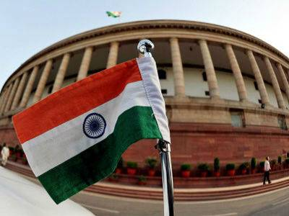
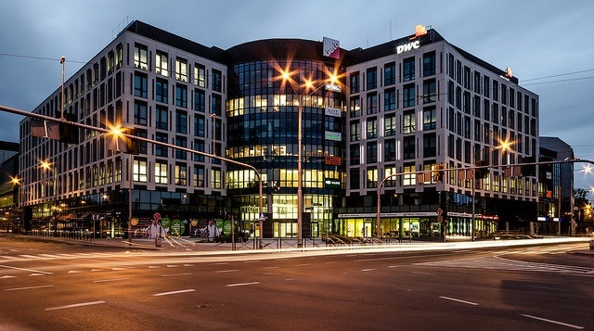

Events and Objectives of the new Companies Act
The Companies Bill-2012 passed by:
Lok Sabha on 18th December, 2012
Rajya Sabha on 8th August, 2013
President’s assent on 29th August, 2013
Replaced existing 57 years old Act of 1956
                Objectives:
                Fewer regulations;
                Self governance;
                Self reporting;
                More disclosures;
                Optimistic and forward looking; and
                reform-oriented legislation.

Slide 3

The new Act is a dynamic Act as 70 % of the Act is based on the rules which signifies that there is no need to go to the Parliament for changes in the Act as the Central Government may make/ amend rules through delegated legislation.

Slide 4


3rd Aug, 2009
Introduction of Companies Bill in Lok Sabha
9th Sep, 2009
Referred to Standing Committee for Examination
3rd Aug, 2010
Receipt of Report of Standing Committee
14th Dec, 2011
Laying down of Companies Bill in Lok Sabha
5th Jan, 2012
Re-referred to Standing Committee for Re-Examination
The Companies Act, 2013 Journey till today…!!!
26th June, 2012
Receipt of report of Standing Committee
18th Dec, 2012
Bill introduced & PASSED by Lok Sabha
8th Aug, 2013
Bill introduced & PASSED by Rajya Sabha
29th Aug, 2013
President of India Assent

Slide 5

THECOMPANIES ACT, 1956
THE COMPANIES ACT, 2013
13
PARTS
658
SECTIONS
29
CHAPTERS
470
SECTIONS
95 DEFINITIONS
15
SCHEDULES
95
DEFINITIONS
7
SCHEDULES
Notified 98 sections w.e.f. 12th September, 2013

Slide 6


CSR for Corporate Sustainability and development of society
Self Regulation and more Disclosures
Flexibility and universally accepted practices
Prevention of corporate frauds and stringent penalties on professionals
Efficient and Effective protection to stakeholders
Simplification and Liberalisation of approvals under the Act.

Slide 7

Elevated Horizons of the Companies Act, 2013
Entrepreneur
Regulator
Investor
Professional
One person company
Self regulation
Simplification and liberalisation of approvals
Related-party transaction
Video conferencing for board meeting
Exemption of different provisions for small companies
Simplification of merger of small, holding & subsidiary companies
Increase in number of members of private limited company from 50 to 200
Self-regulation
increases the time value
Powers of civil & criminal courts
Inclusive growth through liberalised provisions
Systematic dispute resolution mechanism
Class-action suits
Increased Government control
Indirect control through professional accountability
Class-action suits
Benefits of special courts
E-voting
Increased powers to control business as approval of CG in some cases to be approved by shareholders
Wide opportunities for professionals
Holding of key positions as KMP
To act as company liquidator
To act as Registered Valuer
Appointment as independent directors in unlisted companies
Professional expertise as lack of legal awareness will invite stringent penalty
Opportunities to provide Advisory services
Consultancy in CAS
Widen the scope of Internal audit
To conduct Secretarial audit and adoption of secretarial standards
Widen the scope of Cost audit

Slide 8



New Concepts Introduced
Fraud
Statutory Auditors and Audit Committee
One person/ Small/ Dormant /Associate Company
SA & SS
KMP
Registered Valuer
Acceptance of Public Deposits
Penalties of Independent Professional
SFIO
NCLT
NFRA
Woman/ Resident/ Independent Director
CSR
Class Action Suits

Slide 9



New Class of Companies
Key Managerial Personnel (KMP)
Corporate Social Responsibility (CSR)
Independent/ Woman/ Resident Director
Holding- Subsidiary Company and Small Companies Merger
Acceptance of Public Deposits

Slide 10





New Class of Companies
One Person Company
SMALL COMPANY
Dormant Company
ASSOCIATE COMPANY

Slide 11
One Person Company
Sec. 2(62)
One Member
Limited Liability
Separate Legal Entity
Suffix OPC in the name
Not required to hold AGM
Minimum 1 Director & maximum 15
One BM- half yearly Gap- 90 days between 2 meeting
A person can incorporate maximum 5 OPC’s

Slide 12
Small Company
Sec. 2(85)
PROVISIONS
A Private Limited Company.
Paid up capital not exceeding Rs. 50 lacs or such higher amount but not exceeding Rs. 5 crore.
Turnover not exceeding Rs. 2 crore or such higher amount of Rs. 20 crore.
One meeting of board in 6 months.
Can not be a Holding or Subsidiary Company.
Can not be Registered under Section 8.

Slide 13
Dormant Company
Sec. 455
PROVISIONS
Formed to hold an asset, or
Registered for a future project and
No significant accounting transaction.
Defaulting in filing financial statements or annual return for 2 financial years.
Associate Company
Sec. 2(6)
PROVISIONS
A company having significant influence on other company
not a subsidiary company.
Covered in the ambit of Related Party Transaction.
Status of Associate Companies to be disclosed in the Financial Report.

Slide 14

Key Managerial Personnel
(KMP)
PROVISIONS
Certain companies have to appoint KMP.
KMP include:
  Managing Director, Chief Executive Officer, Whole Time Director;
  Company Secretary; and
  Chief Financial Officer
Appointment through board resolution.
Resulting vacancy in the board meeting within 6 months.
Not to hold office in more than one company at the same time.

Slide 15


Corporate Social Responsibility (CSR) Sec.135
PROVISIONS
India first country to include concept of CSR in law.
CSR is not a new concept rather has been nurtured by our rich ethical tradition.
Applicable to companies :
  Networth - Rs. 500 crore or more;
  Turnover - Rs. 1000 crore or more;
  Net profit - Rs. 5 crore or more.
To spend atleast 2% of average net profit of 3 preceding financial years.
CSR committee- atleast 3 directors, one should be independent director.
No penalty if not spent on CSR, merely to disclose in BOD report.

Slide 16

Independent Director
Sec. 2(47)
PROVISIONS
  Certain class of companies to appoint Independent Director.
  Appointment in general meeting for a term of 5 consecutive years.
  At least one meeting of Independent Director’s in a year.
  Not entitled for any remuneration except sitting fee.

Slide 17

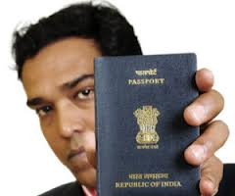
Woman Director
Sec. 149
PROVISIONS
An attempt to improve diversity and remove glass ceiling for woman.
Certain class of companies will be required to have atleast one woman director.
Resident Director
Sec. 149
PROVISIONS
A person who stays in India for 182 days in previous year.
Every company shall have a resident director on its Board.

Slide 18


Holding- Subsidiary Company and Small Companies Merger
Sec. 233
PROVISIONS
No requirement to make an application to the NCLT/ HC for affecting mergers.
Simplified Procedure:
  Approval by 90 per cent of each class of shareholders and creditors and to file a ‘Declaration of Solvency’ with Registrar of Companies (ROC) by the directors of both transferor and transferee company;
  Approved scheme to be filed to CG, ROC and OL;
  If ROC or OL has no objection- CG shall register the same;
  If ROC or OL has objection - submit its objection or suggestion to CG within 30 days who shall file application to tribunal within 60 days and order of the tribunal will be final.

Slide 19

Acceptance of Public Deposits
PROVISIONS
Company can accept deposits from its members subject to approval in general meeting.
Deposits other than its members, to comply provisions:
  to obtain rating from credit rating agencies.
  to do deposit insurance.
  to deposit 15% of amount of its deposit to be matured.
  to create charge on the property and assets of the company.

Slide 20


National Financial Reporting Authority (NFRA)
Stringent Penalties on Independent Professionals
Serious Fraud Investigation Office (SFIO)
Provisions Related to Corporate Frauds

Slide 21

National Financial Reporting Authority (NFRA)
PROVISIONS
CG may by notification constitute the NFRA:
  - to advice on Accounting Standards (AS) & Auditing Standards (AS).
  - to monitor, enforce, compliance and overseeing the quality of service of associated professionals.
Power to investigate the matters of misconduct committed by any member of ICAI or any other prescribed profession and pass order.
Headed by Chairperson and consists of maximum15 members.

Slide 22



Stringent Penalties on Independent Professionals
PROVISIONS
CA’s are liable u/s 447 if acted in fraudulent manner or found guilty of colluding in any fraud by the company/ director/ officer.
CS who certifies the Annual Return otherwise than in conformity shall be punishable with fine which shall not be less than Rs. 50,000/- but which may extend to Rs. 5,00,000/-.
Professional furnishing false or incorrect information during incorporation.
Professional making false statement in any certificate.

Slide 23

Serious Fraud Investigation Office (SFIO)
PROVISIONS
Earlier established by govt. order/ now constituted under Act.
Investigate frauds, relating to company.
Headed by the Director and consist of expert persons of ability, integrity, and experience in corporate affairs, banking, taxation, forensic audit, capital market, information technology law.
SFIO shall submit its investigation report to the CG.
CG may direct the SFIO to initiate prosecution against the company and its officers or employees .
The investigation report deemed to be a report filed by a police officer under the Code of Criminal Procedure, 1973.

Slide 24

Provisions Related to Corporate Frauds
SECTION 447
Includes:
Any act;
Omission;
Concealment of any fact or abuse of position.
By any person or any other person with the connivance in any manner, with intent to deceive, to gain undue advantage from, or to injure the interests of, the company or its shareholders or its creditors or any person, whether or not there is any wrongful gain or wrongful loss.
Contd..p/2

Slide 25

Contd..p/3

Slide 26
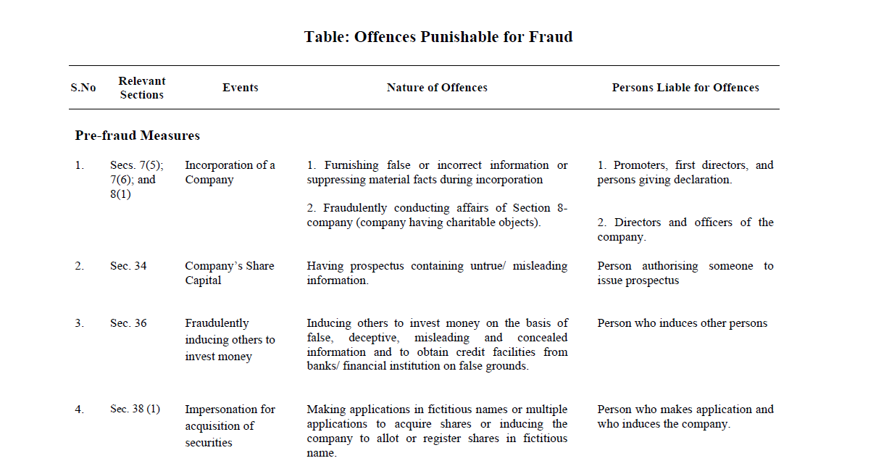
Contd..p/4

Slide 27
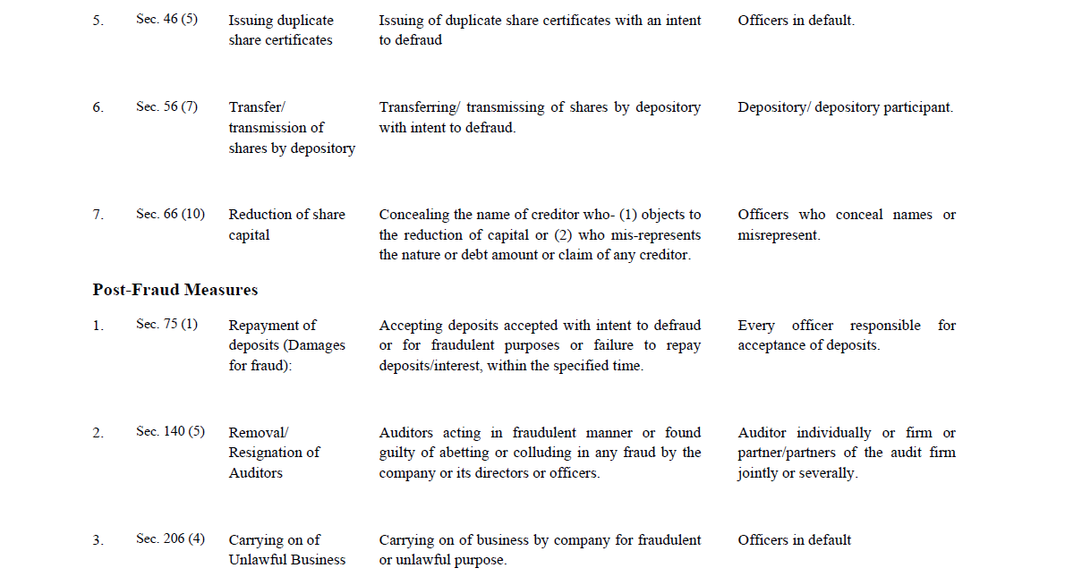
Contd..p/5

Slide 28
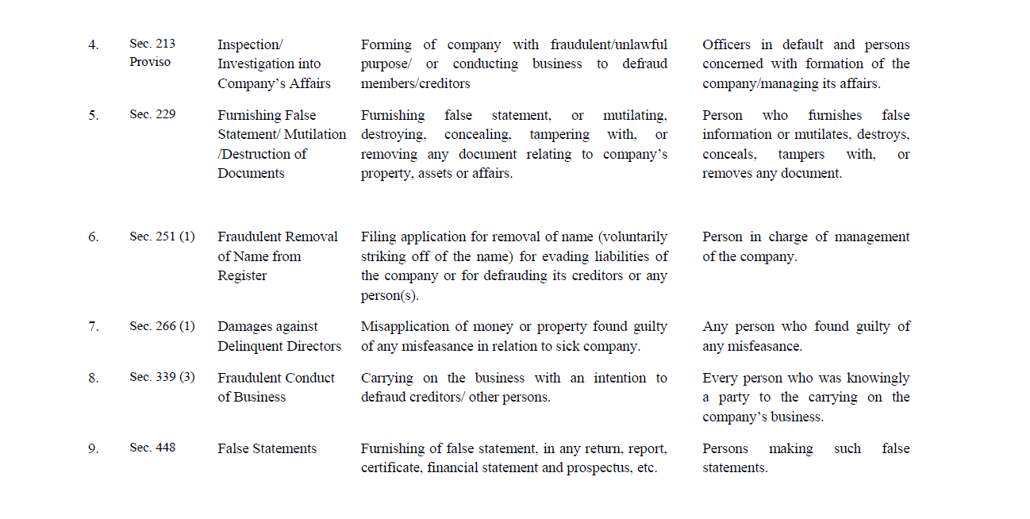
Contd..p/6

Slide 29

Contd..p/6
PENALTY
Imprisonment- 6 months upto 10 years;
Fine equal to quantum of fraud or 3 times of amount involved in fraud;
If fraud involves public interest- Imprisonment of minimum period of 3 years.
Contd..p/7

Slide 30


Statutory Auditors and Audit Committee
Secretarial Audit
Registered Valuer
Secretarial Standards

Slide 31


To hold KMP Position
To act as Company Liquidator
To act as registered valuer
To provide advisory services
Appointment as Independent Director
Consultancy in Class Action Suits
Secretarial Audit
Cost Audit Report
Stringent Penalties leads to Professional expertise

Slide 32
Statutory Auditors and Audit Committee Sec. 177
PROVISIONS
Appointment of:
  Individual Auditor- 5 years
  Audit firm - 10 years
LLP firm may be appointed as an auditor.
Appointment as an auditor- Max 20 companies.
Cannot provide book keeping services and other specified services.
Shall report fraud to the CG.

Slide 33
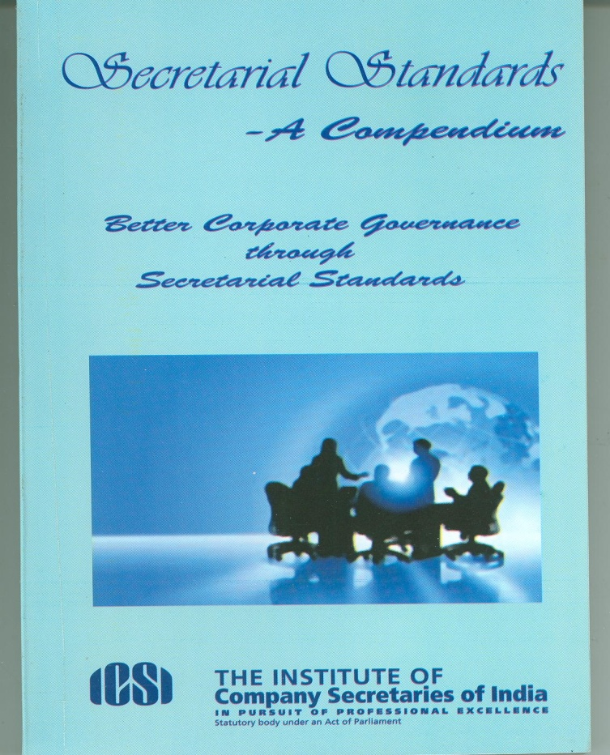
Secretarial Standards
Sec. 118 (10)
Secretarial Standards applicable in respect of :
SS 1 Meetings of Board of Director.
SS 2 General Meetings.

Slide 34
Secretarial Audit
Sec. 204
PROVISIONS
Secretarial Audit by every listed company and certain class of companies.
Secretarial auditors will be a member of ICSI having certificate of practice.
Secretarial audit report a part of BOD Report.
Board report shall explain in full any qualification or observation or other remark.
Stringent penalty between Rs. 1 Lac to 5 Lac in case of default.

Slide 35

Registered Valuer (RV) Chapter XVII
PROVISIONS
Valuer, not having any direct/ indirect interest in the company, is appointed for valuation of property, stock, shares, debentures, securities or goodwill or any assets/liabilities or net worth of the company.
Registered Valuer may be:
* Financial Valuer - values Stock, Shares, Debentures, Securities &Goodwill.
* Technical Valuer- who values Property.
The RV shall have 5 years of post qualification continuous experience.
The RV to be appointed by Audit Committee (AC) or by the BOD in the absence of AC.
Contd..p/2

Slide 36

Scope of Registered Valuer
Further issue of shares: price of share to be determined on the basis of RV report
Compromise/arrangement scheme: the valuation of shares and moveable/immovable property to be determined by RV
Company liquidation event: the report on valuation of assets to be obtained by RV, and
Declaration of solvency in Voluntary winding up: a report of assets of the company be prepared by RV
The RV shall face pecuniary penalties in case of default
Contd..p/3

Slide 37

Financial Valuer
Chartered
Accountants
in WTP
Company
Secretaries
in WTP
Cost
Accountants
in WTP
Retired member
of ICLS
Merchant Banker
Which has CA/CS/CWA
in employment
Technical
Valuer
Member of the
Institute of Engineers
In WTP
Member of the
Institute of Architects
in WTP
Firm/ LLP
Which has members
of IOE/ IOA
Contd..p/4

Slide 38



National Company Law Tribunal and Appellate Tribunal
Sec. 407- 434
Class Action Suit
Sec. 245

Slide 39
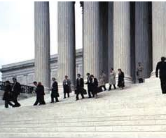
Class Action Suit (CAS)
Sec. 2 45
PROVISIONS
Members or depositors may file suit before tribunal.
If affairs of the company are prejudicial to the interest of the company/ members/ depositors.
CAS not applicable to Banking companies.
Suit may be filed by:-
- company having capital- 100 in number or such % of total number of depositors
- company not having capital- not less than 1/5th of total members
Damages or compensation or any other suitable action from or against:-
- The company/ directors for fraudulent, unlawful or wrongful act or omission
- Expert/advisor/consultant/ any other person for incorrect or misleading statement
Order of Tribunal binding on company member/ depositor/ auditor/consultant.
Penalty on non compliance of order
  - Company - 5 Lacs to 25 Lacs
  - Officer in default – 25,000 to 1 Lac
  with Imprisonment upto 3 years

Slide 40
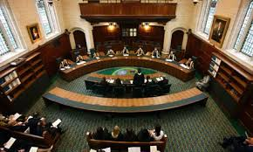
National Company Law Tribunal (NCLT) and Appellate Tribunal (NCLAT)
Sec .407-434
NCLT shall be constituted by Central Government by notification
To replace CLB, BIFR and Appellate authority of Industrial and Financial Reconstruction.
To be headed by President who has been a judge of the High Court for at least 5 years and have such numbers of judicial and technical members.
To exercise powers of CLB, BIFR and powers of High Court(s) in the matter of merger, demerger, amalgamation, winding up etc.
Appeal against order-
- NCLT – NCLAT within 45 days;
- NCLAT – Supreme Court within 60 days.

Slide 41


Significant Modifications
DIRECTORS
Restriction on Number of Directorship: A person cannot become Director in more than 20 Companies and out of this 20, he cannot be the Director of more than 10 Public Companies. The limit of 20 companies includes Private Company.
Independent Directors are Non-Rotational Directors: For the purpose of the calculation of the directors retiring by rotation, the independent directors shall be out of the ambit of Rotational Directors.
Number of Independent Directors in Listed Company: Every Listed Public Company shall have at least one-third of the total number of directors as Independent Directors.
Maximum Number of Directors: The maximum number of Directors in the Company may be 15, with a power to add more directors upon passing of Special Resolution.
Forward of Resignation to Registrar of Companies mandatory: Directors mandatorily required forwarding their resignation along with detailed reason to
the registrar within 30 days of resignation.

Slide 42

Non-Participation of an interested director of Private Company in the matter in which he is interested: In case of private company an interested Director cannot vote or take part in the discussion relating to any matter in which he is interested.
DIRECTORS’ REPORT
Additional Statement in Directors Responsibility Statement: The Directors responsibility statement shall also include a statement of compliance of all the applicable laws.
Additional Information with Board of Director’s Report: The Director’s Report for every Company shall provide additional information, viz, number of meetings of the Board; Company’s policy on Director’s appointment and remuneration; explanations or comments by the Board on every qualification, reservation or adverse remark or disclaimer made by the Company Secretary in his Secretarial Audit Report; particulars of loans, guarantees or investments. This shall not be applicable on One Person Company.
BOARD MEETINGS
Board Meeting through Video Conferencing: Director can participate in the Board Meeting
through video conferencing or other audio visual mode.

Slide 43

Number and Interval of Board Meetings in a year: At least 4 meeting should be held each year and not more than 120 days shall elapse between two consecutive meetings.
ISSUE/ BUY BACK OF SHARES
Allotment of Securities through Private Placement: The Company has to allot the securities within 60 days of receipt of application money, in case the application money received under private placement.
Further Issue of Shares to Employees: The Company can issue further shares to employees by way of ESOP, subject to the approval of shareholders through Special Resolution.
Issuance of Preference shares redeemable after 20 years: A Company may issue Preference Shares redeemable after 20 years for such infrastructure projects as may be specified subject to redemption of specified per cent of Preference Shares on annual basis, at the option of the preference shareholder.
Offer of securities to more than 50 members: The company may make an offer or invitation of securities by way of private placement to more than 50 persons.

Slide 44

Private Company can issue Right/Bonus Shares by Private Placement: A Private Company may also issue securities on Rights basis by way of bonus issue or by way of private placement.
Deemed Public Offer of shares: An offer by a listed/ unlisted company to allot or invite subscription, or enters into an agreement to allot, securities to 50 or such higher number the same shall be deemed to be an offer to the public and it is immaterial whether the payment for the securities has been received or not.
Voting rights of Preference Shareholders: Preference shareholders can exercise voting rights when the dividends payable in respect of a class of Preference shares are in arrears for a period of 2 years or more.
Buy Back of shares by a defaulting Company: A company can buy back its own shares even if it had at any time defaulted in repayment of deposit or interest payable thereon, redemption of debentures or Preference shares or payment of dividend to any shareholder or repayment of any term loan or interest payable thereon to any financial institution or bank, provided a period of 3 years must have lapsed after remedial of such default.

Slide 45


ANNUAL RETURN
Additional Information in Annual Return: Every Annual Return shall contain the additional information like particulars of its Holding, Subsidiary and Associate Companies, Matters related to certification of compliances, disclosures for remuneration of directors and Key Managerial Personnel etc.
Certification of Annual Return by Practising Company Secretary: Companies with specified Paid-up Share Capital and Turnover shall be required to certify the Annual Returns by a Practising Company Secretary.
Listed Company to file return for change in Promoters and top ten Shareholder’s holding: Every listed Company shall file a Return to Registrar of Companies in respect to change in the number of shares held by promoters and top ten shareholders within 15 days of such change.

Slide 46

PRIVATE / PUBLIC COMPANY
Increase in number of members of Private Limited Companies: A private company can
now have as maximum as 200 members.
Obtaining Certificate of Commencement of Business by Private Company is mandatory: Private Companies like a public company (having share capital) are also required to obtain certificate of Commencement of Business within 180 days of incorporation.
Maintenance of Registered Office and to file verification of Registered Office: A company shall have a registered office on and from 15th day of its incorporation and company shall furnish to ROC a verification of Registered Office within 30 days of its incorporation. Form 18 is to be filed now within 15 days of change of registered office of the company.
Provision for Appointment and Remuneration of Managerial Personnel extended to Private Limited Company: Provision related to appointment of Managing Director/ Whole Time Director/ Manager shall also apply to Private Company.

Slide 47

GENERAL MEETING
Shorter Period for Conducting of First Annual General Meeting: First Annual General Meeting of the Company shall be held within the period of 9 months from closure of its first financial year.
AGM can also be held on Sunday
No Bifurcation of Object Clause of MOA: Memorandum of Association of a Company shall now contain only the objects for which the company is incorporated along with matters considered necessary for its furtherance.
Disclosure of material facts in explanatory statement: Disclosure of material facts is mandatory with regard to nature of concern / interest, financial or otherwise in respect of every director/ Manager/ KMP and relatives of such person.
Certain powers require Ordinary Resolution will now require Special Resolution: Powers which Board can exercise with the approval of general meeting by way of ordinary resolution under section 293 of the Companies Act 1956 shifted to be passed by special resolution.

Slide 48

Quorum: The articles may provide for a larger number to the below mentioned quorum:-
(i) Public Company - 5 members up to 1000 members
-15 members up to maximum of 5000 members
-30 members if more than 5000 members
(ii) Private Company -2 members personally present
LOAN AND INVESTMENT
Two Layers of Investment Companies: A Company can make investment through two layers of investment Companies.
Inter-Corporate Loans and Inter-Corporate Investment to include Loan to any person: The provisions related to Inter-Corporate loans and investment has been extended to include loans and investment to any person also.
No Guarantee By Group Company: The company in which directors are interested, directly or indirectly cannot give guarantee in favour of another company in case of financial facilities from bank/ financial institutions.

Slide 49

CONSTITUTION OF VARIOUS COMMITTEES, PANEL & COURTS
Constitution of Remuneration Committee: Every listed company and prescribed class or classes of companies, shall constitute the Nomination and Remuneration Committee consisting of 3 or more Non-Executive directors out of which not less than one half shall be independent Directors.
Constitution of Stakeholder Relationship Committee: Every company which consists of more than 1000 shareholders, debenture –holders, deposit- holders and any other security-holders at any time during a financial year shall constitute a Stakeholder Relationship Committee consisting of a chairman who shall be a non – executive director and such other members as may be decided by the board.
Establishment of Mediation and Conciliation Panel: The Central Government is required to establish Mediation and Conciliation Panel for mediation between the parties during the pendency of any proceedings before the Central Government, the Tribunal, or the Appellate Tribunal.
Establishment of Special Courts: The Central Government for the purpose of providing speedy trial of offences shall establish Special Courts.

Slide 50

FINANCIAL STATEMENTS
Financial Statement Meaning: Balance Sheet and Profit and Loss Account, collectively known as financial statement and Cash Flow Statements forms part of the same.
Uniformity in Financial Year: Financial year of each company will be from April-March and only certain companies can have a different financial year with the approval of the National Company Law Tribunal.
Books of Accounts in E-Form: The Act recognizes the fact that books of accounts may be kept in electronic form also.
Consolidated Financial Statements to be laid at Annual General Meeting: Consolidated financial statements of all Subsidiaries, Associates, and Joint Venture Company will be prepared and shall also be laid before the Annual General Meeting with Financial Statements.

Slide 51

CHARGES
Registration of all type of charges: It is necessary to register all types of charges whether created within or outside India. The Charge is to be filed within 30 days, however, ROC can register such charge within additional 270 days on payment of additional fees.
NEW DESIGNATORIES AS OFFICERS IN DEFAULT
Some new designatories as Officer in Default: ‘Officer in Default’ will also include ‘Share Transfer Agents’, ‘Registrars and Merchant Bankers to the issue’ or transfer related to issue of shares and Chief Financial Officer, Directors who are aware of the default by way of participation in the Board’s Meeting or receiving the minutes without objecting to the same even if the Company has a Managing Director/Whole-Time Director / Other Key Managerial Personnel.
DIVIDEND
Not mandatory to transfer a portion of profits to reserve before Dividend Declaration: A Company can on its discretion transfer such per cent of profits to the reserve before declaring dividend as it deem necessary, moreover, such transfer is also not mandatory.

Slide 52

Compromise, Arrangement and Amalgamations
Compromise, Arrangement and Amalgamations: Only persons holding not less than 10 per cent of the shareholding or having outstanding debt amounting to not less than 5 per cent of the total outstanding debt as per the latest audited financial statements, shall be eligible to raise any objection to an arrangement or compromise.
Dispensation of Creditor’s meeting in case of Compromise and Arrangement: The Tribunal may dispense the condition of calling of meeting of creditor or class of creditors where such creditors, having at least 90 per cent value has agreed and confirmed, to the scheme of compromise or arrangement by way of an affidavit.
Scheme of Compromise and Arrangement to be sanctioned only on filing of Auditor’s Certificate: The tribunal shall not sanction any compromise or arrangement unless a certificate by Company’s Auditor has been filed with the Tribunal stating that the accounting treatment proposed in the scheme of compromise or arrangement is in conformity with the accounting standards.

Slide 53

Compoundable Offences: Only offences punishable with fines shall be compoundable, while offences punishable with fines or imprisonment and fine or imprisonment or with both will be compoundable with the permission of special court.
Unlisted Company may continue as unlisted even if listed company is merged into it: The Act provides that in case of merger of Listed Company in Unlisted Company, the Tribunal can order that unlisted Company i.e. Transferee Company shall continue to be unlisted.
Declaration of Sick Company and Criteria of Sick Company dispensed with: Any company can be declared as a ‘sick company’. The criteria of erosion of 50% of the net worth for declaring the company as sick have been dispensed with.
Power of Civil Court to Registrar: In case of inspection or inquiry the Registrar shall possess powers as are vested in a Civil Court under the Code of Civil Procedure, 1908.

Slide 54
Central Government approval for Related Party Transaction abolished: No approval of the Central Government is required for entering into any related party transactions.
Search and Seizure at the place of Key Managerial Personnel, Auditor and Practising Company Secretary: Registrar/ Inspector shall be empowered to search and seizure at the places of Key Managerial Personnel, Auditor and Practising Company Secretary.
Investigation of Related Company during Investigation of Ownership Company: The affairs of related company can also be investigated.
Maximum period to file any document/ return: Any document or returns required to be filed have to be filed within a period of 270 days on payment of additional fees.
Search and Seizure at the place of Key Managerial Personnel, Auditor and Practising Company Secretary: Registrar/ Inspector shall be empowered to search and seizure at the places of Key Managerial Personnel, Auditor and Practising Company Secretary.

Slide 55
Cross-Border Merger: The Indian Companies can be merged with the other Companies, incorporated in such countries to be notified by the Central Government.
Maximum period to file any document/ return: Any document or returns required to be filed have to be filed within a period of 270 days on payment of additional fees.
Investigation of Related Company during Investigation of Ownership Company: The affairs of related company can also be investigated.

Slide 56


The Indian Economy has witnessed a drastic change during 2, 3 decades and as per current economic scenario the present Companies Act, 1956 is sort to be overhauled to make it more adaptable to the changing environment.
The Companies Act, 2013 has some prominent parts like the provisions for Corporate Social Responsibility, Class-action Suits, National Company Law Tribunal, One Person Company, Key Managerial Personnel and Serious Fraud Investigation Office, easy liquidation, quick winding up, and fixing liabilities which will really going to make doing business a little bit easier then it is today .
There has been a paradigm shift in the regulatory landscape of Indian company law. The Companies Act, 2013 is the forward-looking, reform-oriented and investor-friendly legislation. The new Act will surely helpful in preventing corporate fraud.

Slide 57


Dr. Sanjeev Gupta
M.Com., FCS, LL.B, MIMA, Ph.D
Director
La- SIYA Corporate Consultants Pvt. Ltd.
709 A Tower B, Pearls-Omaxe, Netaji Subhash Place
Pitampura, New Delhi 110034
9810079134- 35
lasiya.inc@gmail.com
www.lasiyaconsulting.com

Slide 58
Dr. Sanjeev Gupta
M.Com., FCS, LL.B, MIMA, Ph.D
.
709 A Tower B, Pearls-Omaxe, Netaji Subhash Place
Pitampura, New Delhi 110034
9810079134- 35
lasiya.inc@gmail.com
www.lasiyaconsulting.com

